Slide 1

Fertilized Egg Detection
Student Name: RR Matumane
Student No.: 215420469
Presentation Date: 04 November 2023

Slide 2

Abstract
This study presents a comprehensive approach to fertility detection of multiple chicken eggs in the incubation industry, based on image processing techniques and a Convolutional Neural Network (CNN). The aim of this research was to design and implement a system capable of simultaneously distinguishing between multiple eggs' infertility and fertility. To achieve this, an LED light source was set up to illuminate a batch of 48 eggs, consisting of both types, randomly placed on a tray in a dark box. Additionally, a pre-trained CNN was employed to classify fertile and infertile eggs. All eggs were captured and processed to extract a region of interest (ROI) for each egg, generating a large ROI egg image dataset that was used to train and test the CNN model. The designed system was programmed using Python, operating on Windows 7-64bit, supported by OpenCV and Keras. Experimental results demonstrated that the accuracies for fertile incubated egg detection between day 7 and day 9 reached 100%. Moreover, the system exhibited 100% accuracy in eggs' location. Hence, the proposed technique showcased high reliability, high accuracy, and suitability for real-world applications. The integration of image processing techniques and CNNs presents a promising solution for effectively managing and optimizing the incubation process in the poultry industry. Keywords: hatching eggs; fertility detection; CNN; pre-trained; incubated ; deep learning; incubator images

Slide 3
Introduction
Chicken production is one of the key sectors in the food industry, playing a pivotal role in SA's ambitious goal to become the kitchen of the world, a crucial government policy. SA has emerged as one of the top five largest countries in the world, producing over 2.1 million tons of chicken products in 2016, primarily for export [1]. Central to this industry's operations is the supply of day-old chicks, with the incubation industry serving as a critical supplier. The fertility and hatchability of eggs are essential factors that significantly influence the chicken industry, with fertility denoting the ratio of fertile eggs to incubated eggs, and hatchability referring to the ratio of hatched fertile eggs to all fertile eggs [2]. Early detection of infertile and underdeveloped eggs could enable hatcheries to improve hatching rates, conserve incubator spaces, reduce handling costs, and prevent the spread of infections from non-viable eggs [3].
Candling, a method for examining hatching eggs during incubation, involves illuminating the eggs with a focused light source in a dark box, enabling the inner side of the eggs to be visible. This process allows for the differentiation between infertile eggs, early-stage dead embryos, and fertile eggs. The manual candling process, however, is labor-intensive, with only a small percentage of eggs (about 5%) being randomly examined. The reliance on manual labor results in the loss of efficiency due to employee fatigue and human errors, necessitating the expertise of skilled workers for the precise separation of fertile and infertile eggs [4]. While various methods such as hyperspectral imaging, ultrasound, heart rate detection, oxygen flux detection, visible/near-infrared transmittance spectroscopy, and thermal imaging have been proposed for non-destructive automatic detection of fertile eggs, these techniques are often costly and complex[5].
Recently, several researchers have proposed low-cost fertility detection instruments utilizing light-dependent resistors and temperature sensors. Although these methods demonstrate cost-effectiveness, the process of classifying between fertilized and non-fertilized eggs remains intricate. Automated systems using computer vision for fertility detection have shown promise in achieving high accuracy while ensuring cost-effective implementation [6][13][14][15][16]. However, existing methods primarily focus on inspecting single eggs, with limited attention given to simultaneously inspecting multiple eggs. While some approaches have shown the potential for multi-egg inspections, the achieved accuracy remains relatively low [17].
Given the recent prominence of convolutional neural networks (CNNs) in practical image classification tasks, various researchers have successfully applied CNNs across diverse fields, including agriculture, medicine, robotics, and traffic enforcement [18][19][20][21]. This paper presents a novel approach to simultaneously detect multiple fertile eggs based on image processing techniques and a CNN. The system enables the localization and sorting of eggs through image processing, where resized images are fed into a pre-trained CNN model to classify between fertile and infertile eggs. The CNN model comprises three convolutional layers and two fully connected layers. This paper is organized as follows: an overview of the proposed model, an explanation of the egg location and fertile egg detection technique, presentation of experimental results, and conclusion

Slide 4
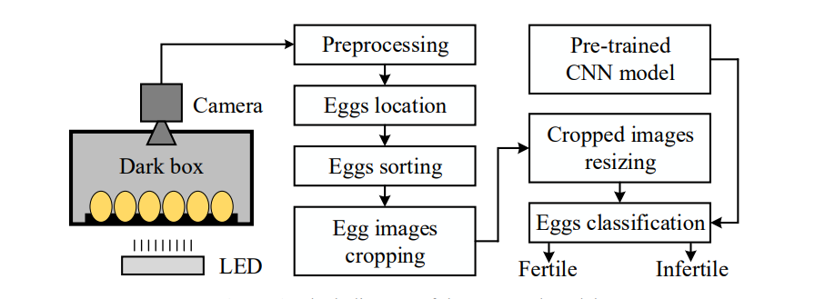

Slide 5
Literature review
Previous research in the field of poultry farming has mainly focused on manual egg detection and classification, with limited efforts directed towards the development of automated systems. Some studies have explored the use of traditional image processing techniques for egg detection, but these methods often suffer from limited accuracy and reliability. On the other hand, advancements in deep learning, particularly in the field of computer vision, have led to the emergence of Convolutional Neural Networks (CNNs) as powerful tools for image classification tasks. Several studies have successfully applied CNNs in various agricultural domains, demonstrating their potential for automating tasks such as plant disease detection and crop monitoring. However, the application of CNNs in the context of egg detection and classification in the poultry industry remains relatively unexplored.

Slide 6
Methodology
The proposed methodology involves a multi-stage process, starting with the collection of high-resolution images of chicken eggs. The collected images are preprocessed using various image enhancement techniques to improve the quality and clarity of the images. Subsequently, the preprocessed images are fed into a trained Convolutional Neural Network, which has been specifically designed and optimized for the detection and classification of chicken eggs. The CNN utilizes a deep learning architecture to analyze the features of the eggs and accurately determine their fertilization status. The backend of the system is implemented in Python, which provides the necessary libraries and tools for image processing and deep learning, while the user interface is developed using Angular, enabling an intuitive and user-friendly interaction with the system

Slide 7
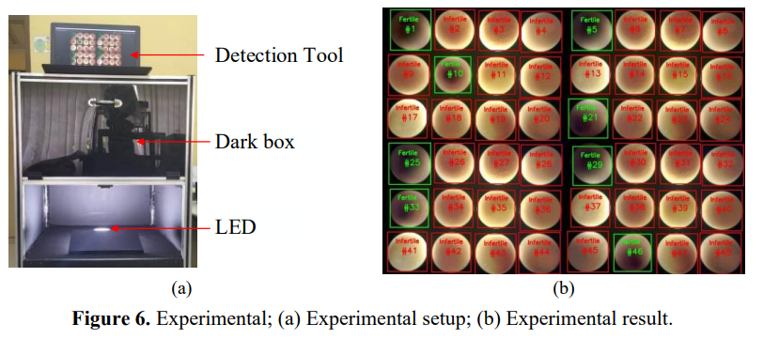
Results and analysis
To verify the performance of the proposed model, an experimental setup illustrated in Figure 1 was implemented, as depicted in Figure 6(a). A total of 240 eggs, consisting of 8 fertile eggs (7-9 days) and 100 infertile eggs that the CNN pre-trained model had not previously encountered, were used to validate the model's effectiveness. The 30 eggs, a mix of both types, were randomly positioned on a tray for the detection process, utilizing the sources described in the training process outlined in section 3.3. The egg positioning process was facilitated using OpenCV.
The results of the experimental validation demonstrated that the proposed model exhibited 80% - 100% accuracy in both egg location and fertile egg classification for the entire set of 240 samples, emphasizing the robustness and reliability of the system. Notably, the accuracy of the fertile egg detection was compared with the results achieved by experts specializing in fertile egg classification, showcasing the system's proficiency in accurately and consistently identifying fertile eggs within the batch. The experimental validation underscores the effectiveness of the integrated image processing and CNN-based approach in achieving precise and reliable multi-egg detection and classification in the context of chicken egg fertility.

Slide 8
Conclusion
My proposed system for the fertile/infertile control of chicken eggs incorporates image processing and deep learning techniques. Initial violet images of 30 eggs were captured with a camera positioned in the incubator, followed by the implementation of the segmentation process. Two image databases were created, one containing few fertile eggs and the other containing many infertile eggs, for the purposes of segmentation and fertilized egg detection, respectively, employing a Mask R-CNN approach.
Upon reviewing the literature on egg fertility control, it is evident that studies predominantly utilize either classification or segmentation techniques on egg images for feature extraction, rarely aiming to both classify and segment images using the same neural network model. In contrast, our study proposes the utilization of a single model for detecting, segmenting, and classifying fertile and infertile eggs. Evaluation of the results obtained in our study indicates that fertility control can be accurately conducted as early as the third day, with the AP value observed to be 1 on the third day. Considering the applied methods and the simplicity of the designed system, it can be asserted that a highly successful system has been developed, aligning with previous studies in the literature.
We used IoU and AP measurement metrics, widely accepted in the literature, to assess the segmentation performance. Our study demonstrates that AP measurement values are higher when selecting IoU = 0.7. Analyzing the data obtained from the tests of the segmentation and fertile egg detection processes applied to both image databases, we observed that all fertile eggs were correctly detected by the end of the third day. Notably, the segmentation performance significantly influenced the accurate detection of fertile eggs, as evidenced by the parallel relationship between the obtained AP values in segmentation and the number of correctly detected fertile eggs.
Thus, it is apparent that improving the segmentation performance holds greater significance than merely focusing on the detection of fertile eggs. Consequently, to enhance the segmentation performance, conducting experimental studies to refine the camera and lighting setup used for image capture is crucial. In the continuation of this research, we aim to further develop the image acquisition mechanism.
The method proposed in this study holds potential for the fertility control of all poultry eggs. While a commercial product has yet to be developed, we remain committed to advancing the development of a commercial product using the proposed method

Slide 9
References

